Slide 1
CS 688
Sports Data Analytics
Term Project
Yung-Chieh (Jerry) Yang

Slide 2

Sports: Basketball

Slide 3
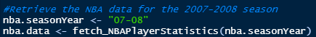
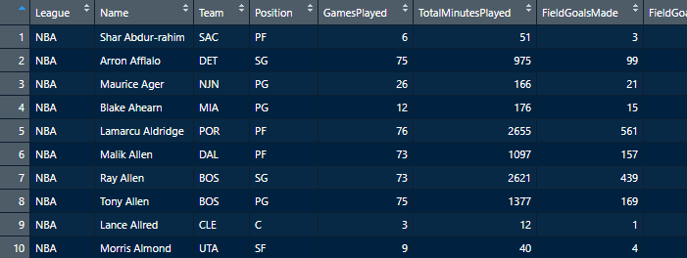
Retrieve the NBA data for the 2007 - 2008 season
451 players were in the NBA during 2007 - 2008 season

Slide 4



Subset the data for my favorite team
What I choose is the
Los Angeles Lakers

Slide 5
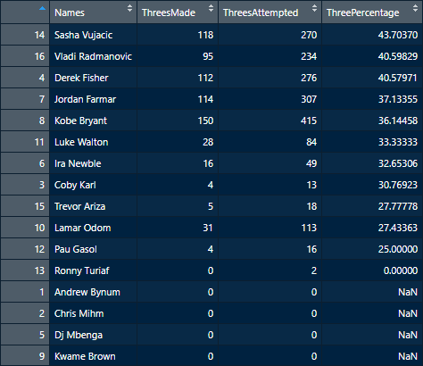
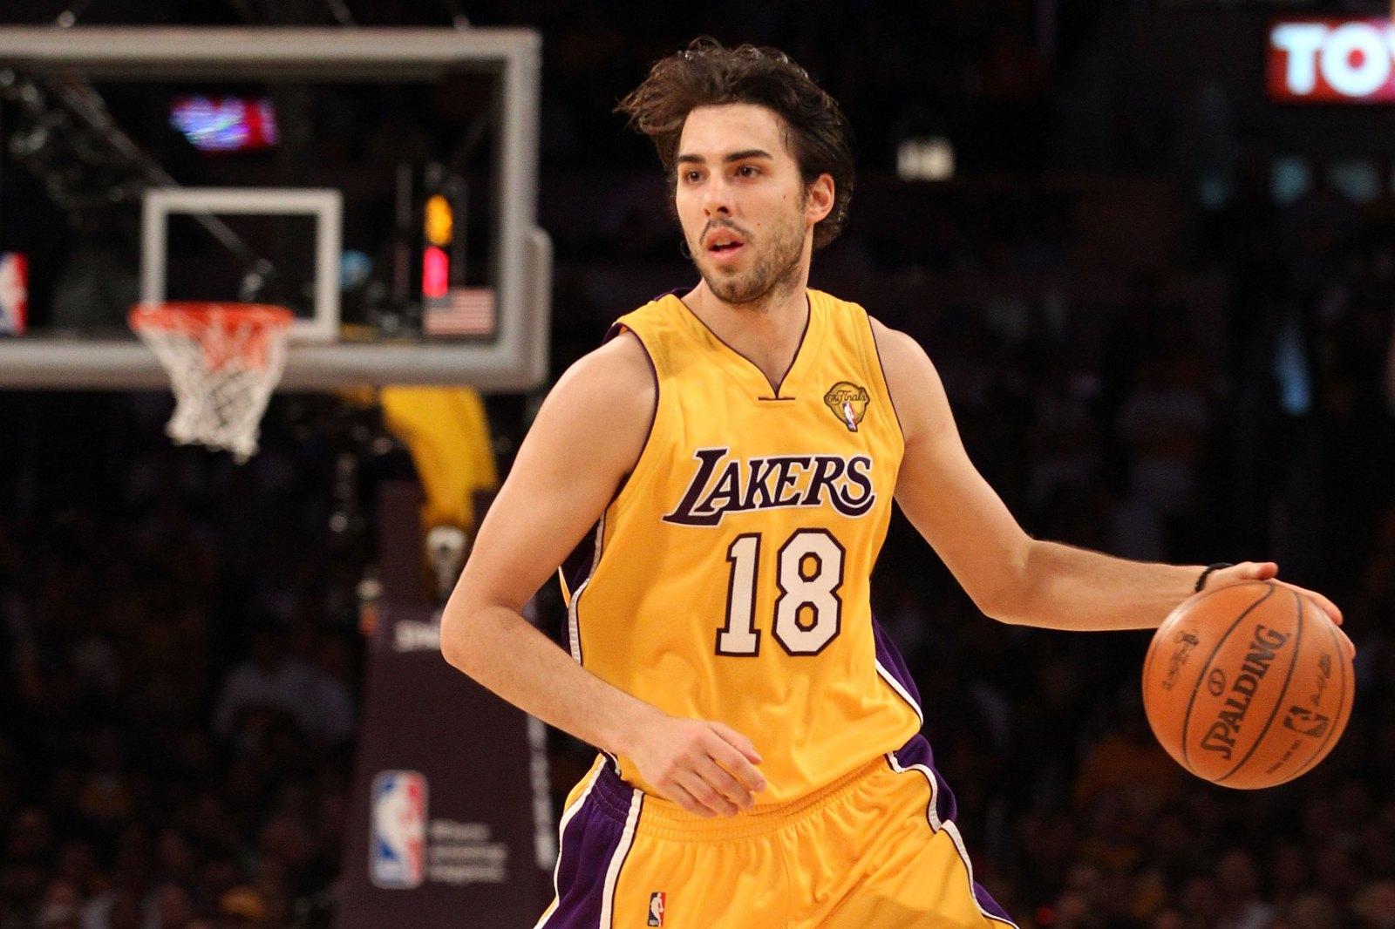
LAL players best three point percentage
Sasha Vujacic
Has the best three point percentage
With 43.7%

Slide 6
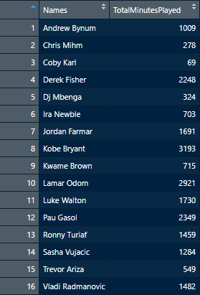
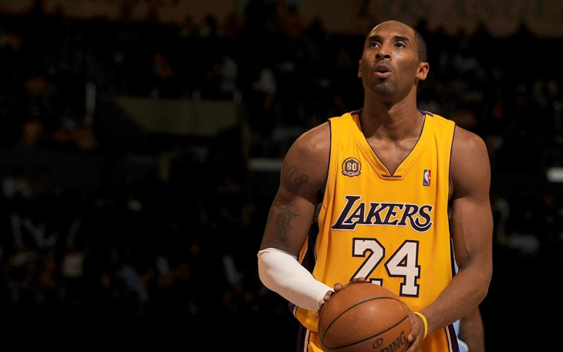
LAL players largest number of playing minutes
Kobe Bryant played the most minutes (3193 minutes)

Slide 7
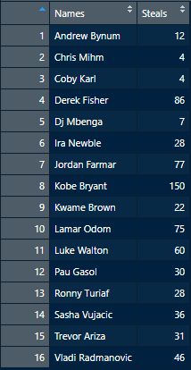
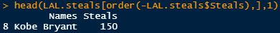
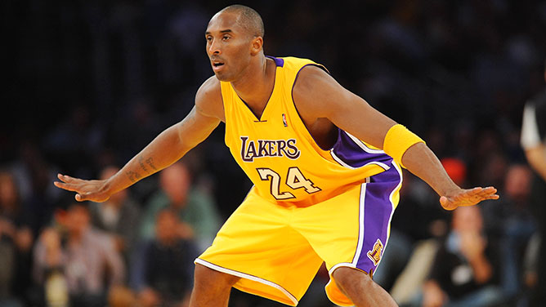
LAL players most steals
Kobe Bryant has the most steals (150 steals)

Slide 8
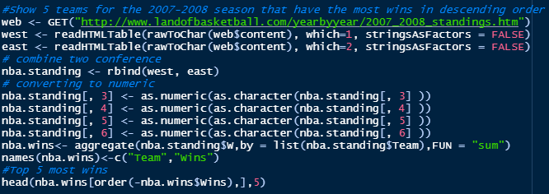
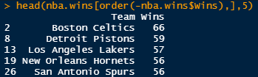
5 teams 2007 - 08 season that have the most wins

Slide 9
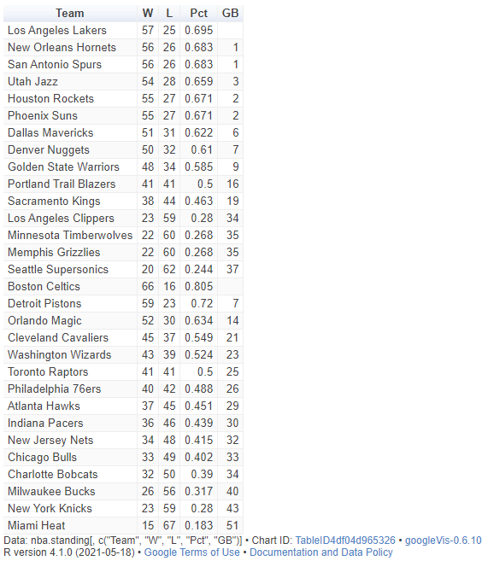
Google Charts -- Google Visualization Table

Slide 10
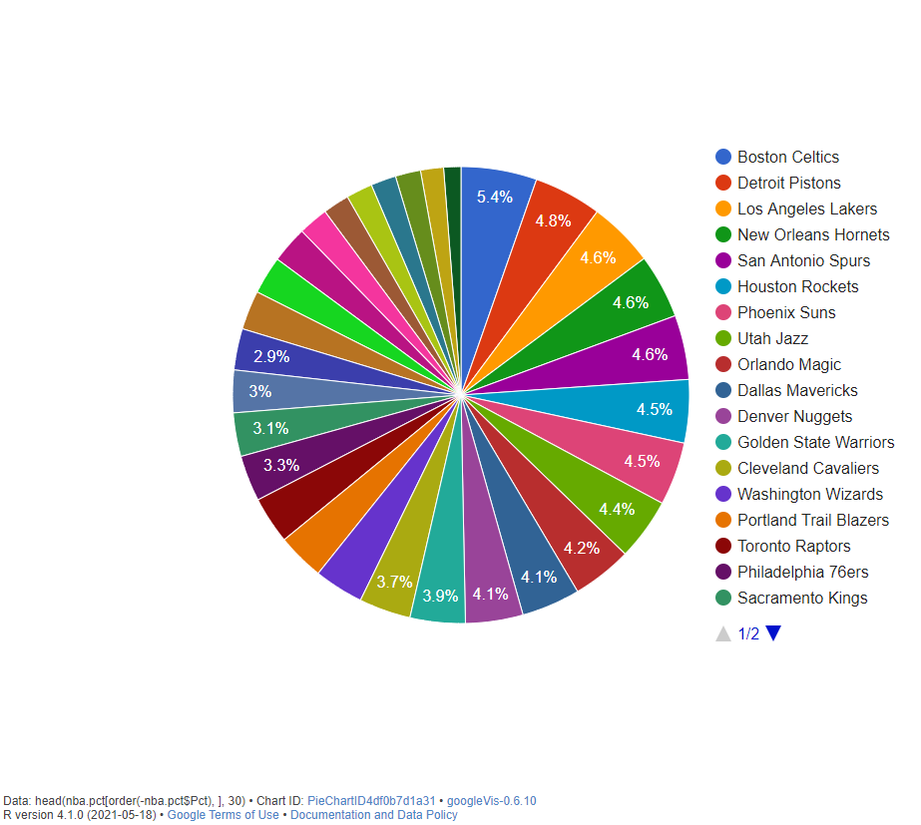
Google Charts -- 30 teams wins Pie Chart

Slide 11
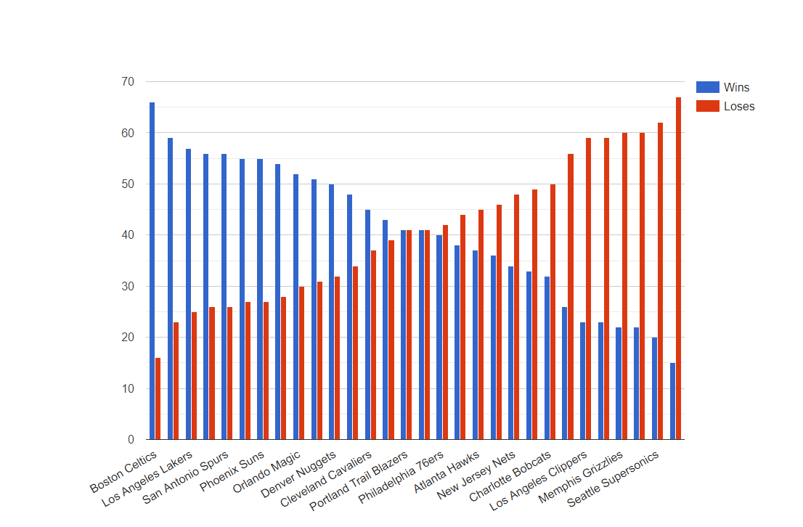
Google Charts -- 30 teams wins/loses Column Chart
The worst team Miami Heat’s losing record (67 loses) is even greater than the best team Boston Celtics’ winning record (66 wins)

Slide 12
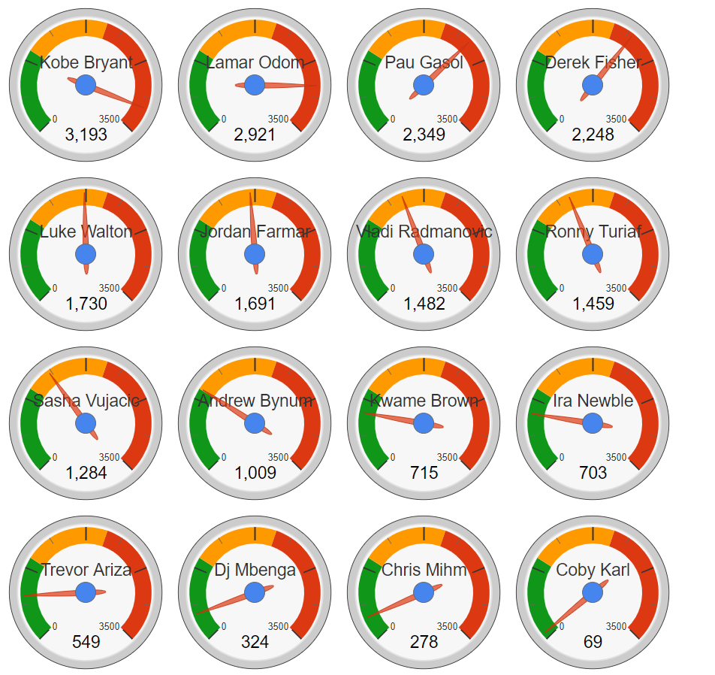
Google Charts -- LAL playing minutes Gauge Chart

Slide 13
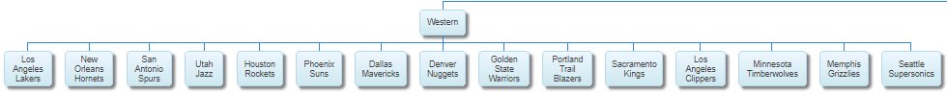
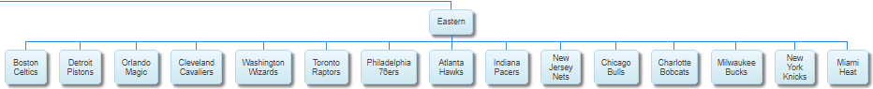
Google Charts -- NBA Organizational Chart

Slide 14
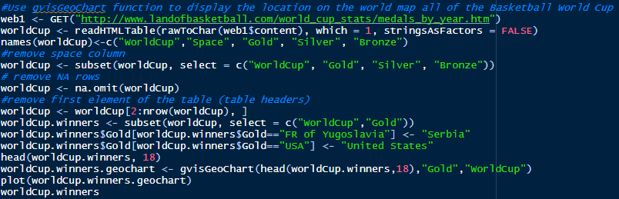
gvisGeoChart Basketball World Cup Champion

Slide 15
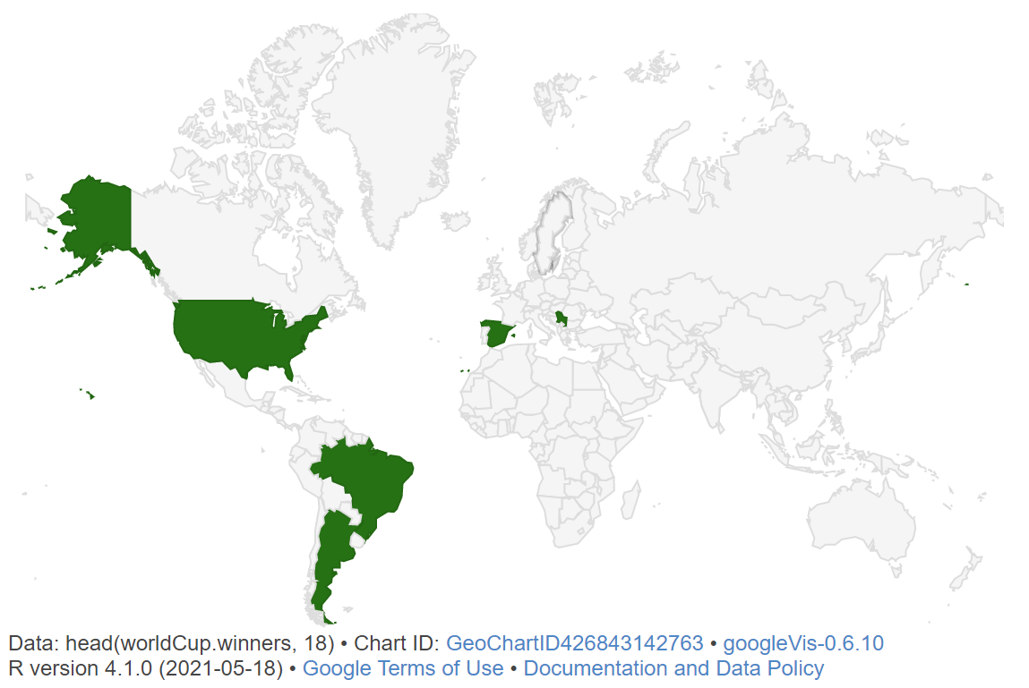
gvisGeoChart Basketball World Cup Champion

Slide 16

The END

